Slide 1
Urban Environmental Theology
Idealists in the Slums – will they change the future cityscapes?

Slide 2
Some Thoughts on the TUL655: Advocacy and the Urban Environment
Idealists in the Slums – will they change the future cityscapes?

Slide 3
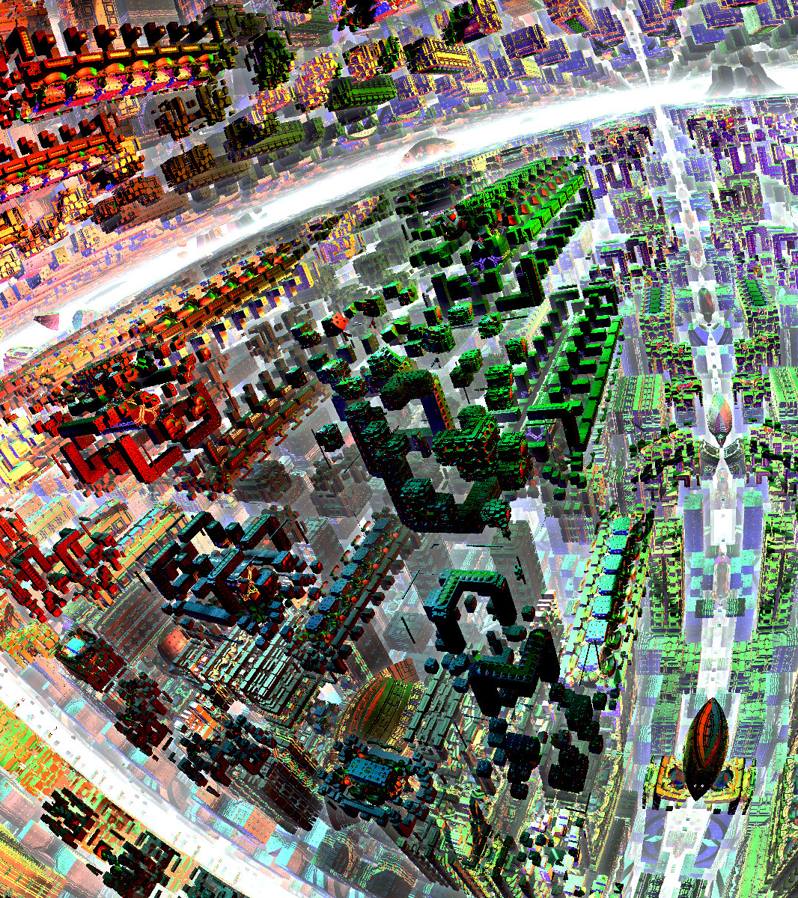
Urban Theology: God’s Envisioning of the Human Habitat
(Genesis Nature of God in a Garden predicts the Garden in the Holy Life-giving Cubic City)
In seeking to discern God’s will regarding the created order (earth), the context of theology assumes major importance. The context shifts from a primary focus on me and my salvation to the well-being of human communities and the planet. Individuals are embedded in a network of social and ecological relationships, and shaped by forces that operate on a transnational level.
Our eco-social and global context calls theology to view the self or subject, not as an individual who is “saved” for life in another world, but as one who is embodied, relational, and interdependent with everyone and everything else.
Richard Slimbach
http://fc01.deviantart.net/fs70/f/2013/350/8/a/levitation_city_by_fractales75-d6y6pf9.jpg
Urban Planning as a Reflection of God’s Work

Slide 4
Table: Two Poles of
Urban Habitat Theology
 | Local Issue: slum community theology | Global Theology of the urban environment
Presence of Spirit | Training Families in Environmental Bible Studies | Hovering over creation of urban globe
Restoration of Creation | Proactive Engagement in Sites and Services with water, space, garbage collection and gardens | Moving creation to a City in which is the garden and life-giving stream with healing trees
Manage the Earth | Slum community as human growth environment | Cities as Human Habitats
What are ten principles of the environment in the scriptures?
What is the Global Conversation to which they are linked?
What is the Slum Conversation to which they are linked?
The Biblical Vision drives the Human Local Issues Engagement

Slide 5
Local Issue – Global Theologies
We have chosen to design this course with a focus on the grassroots issue – “no land, little development of the slum environment” - and the practice of transforming the core issue for the poor of land tenure and with that of then transforming the slum environment with sites and services, interfaced with urban planning authorities. This paper approaches it from a perspective we chose to leave as peripheral to the core of grassroots issues, the macro-American view of global environmentalism. However reference to this massive field is included in this paper to bridge the gap between these two locational-cultural perspectives and open the door to wider studies in this field.
Likely a number in this program over the years will find this leads to a pathway to integrate their faith and global environmental change, and the proclamation of a gospel that brings not only redemption to individuals, but restoration of the created order through the structures of engagement with creation, an environmental gospel that requires public repentance on a massive scale.

Slide 6
Roots of Environmental Theology
God-Humanity-Creation linkages in the creation narratives.
What was our definition of the Kingdom of God?
His reign over all, resulting in the redemption of humanity and restoration of creation.
God
Creation
Humanity
Humanity
Redeems
Rules
Kingdom of God
Rules
Restores
Rules

Slide 7
Anthropocentric-
Human Centred
Early environmentalists, such as Lyn White Jr, heavily criticised the Judeo-Christian traditions for being one of the major vehicles for the destruction of the earth.
Particularly Christianity, which underpinned western civilisation for the past 1500 years, was seen as having an ANTHROPECENTRIC (human centred) view when it came to ethics.
Christians placed human concerns at the centre of ethical considerations and the earth was for humans to do with what they like.
The source of this viewpoint was that Christians believed that the earth and everything on it was given by God to man to rule over and subdue because Genesis 1:28 states:
And God blessed them, and God said to them, 'Be fruitful and multiply, and fill the earth and subdue it; and have dominion over the fish of the sea and over the birds of the air and over every living thing that moves upon the earth'" (Genesis 1:28).

Slide 8
Throughout its history, many Christians literally interpreted this to mean that “man” could do what “he” liked to the environment as God gave DOMINION to “him”.
Another aspect was that Christianity was also heavily influenced by Greek philosophy which saw the world ordered hierarchically with nature being very low on the hierarchy.
Unfortunately, these two viewpoints allowed Christians to adopt a very ANTHROPECENTRIC focus and not consider their destruction of the environment as a moral dilemma.
There are some Protestant Variants, such as some Evangelical and Pentecostal churches, who hold an anthropecentric world view as they still literally interpret the Bible
Science was to adopt a very similar position as early science was heavily influenced by Christianity.

Slide 9
Current views on environmental ethics within Christianity are still based on these two view points. It seems that the variants that base their ethical teachings on the literal interpretation of the Bible, tend to have an anthropocentric point of view, whereas, other variants tend to have a combination of biocentric and anthropocentric

Slide 10
Biocentric-Environment focus
The Biocentric view places the environment at the centre of concern.
Extreme versions of a Biocentric world view, such as those by Deep Ecologists, place the environment on equal or higher importance than human needs. Very few Christians adopt this stance.

Slide 11
Christian Environmental Ethical Position.
Anthropocentric
Biocentric
  Environment centred
  based on all life on Earth was created equally for all by God.
Human centred based on Dominion principal.
Influenced by literal Interpretation of Bible to guide ethical decision making
Combination where human needs are important, but need to look after God’s creation “Stewardship Principle

Slide 12
Readings – Limit it to urban habitat and urban theology of place

Slide 13
Creation Theology
(Green Theology)
As a result of Christians re-evaluating their position on the environment there has been a push towards a Creation Centred Theology
Creation Theology is concerned with the cherishing of all life and all people, as gifts from God. Creation Theology (or Green Theology) is influencing the Christian position on the environment as it encourages Christians to focus on God’s creative power and for them to appreciate that this is important. By valuing God’s creative power we as humans would not purposely destroy the environment.
There are many examples of Creation Theology playing a key role in many Christian Churches:
  Declaration on the Environment Document (Catholic and Orthodox)
  Sustaining Creation (Ecumenical Position)
  Pastoral Letter by Queensland's Bishops on the Great Barrier reef

Slide 14
Hildegard of Bingen
Hildegard of Bingen was a leader of a monastic community in the 12th century. She was a famous student of nature who investigated and made use of the healing qualities of nature and taught of the need to respect nature and learn from it. Her writings, music and art all reflect a profound sense of oneness with creation and an immense respect for the work of the creator.
A number of these slides are from Steven Newman

Slide 15
Some Thoughts on the TUL655: Advocacy and the Urban Environment as a course on
Environmental Theology
Idealists in the Slums – will they change the future cityscapes?

